Slide 1
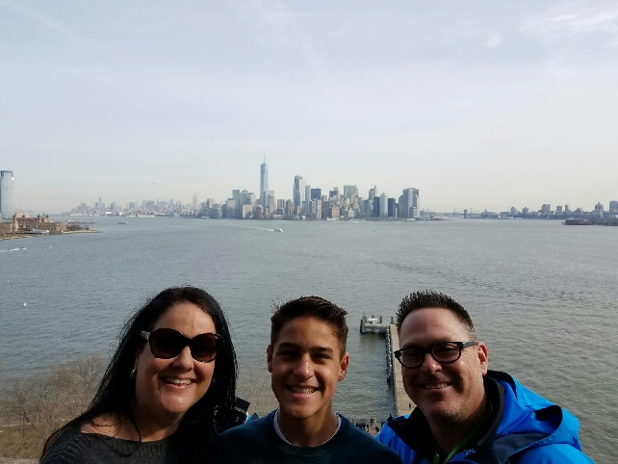
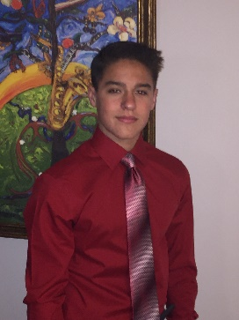
The Basics!
Hi! My name is Christine Henderson! I will be your child’s 4th grade teacher for the 2019-2020 school year! This will be my 22nd year teaching and 14th year at Gretna No.2 Academy. I am married to Shawn, a nurse, and have a son, Jack. I also coach the Patrick Taylor Volleyball team.
My Childhood!
I grew up in Terrytown, Louisiana where I attended JPPSS schools from K-8. I enjoyed playing sports such as track, volleyball, basketball, & softball at the Terrytown Playground. Go Fighting Irish!! I graduated from Archbishop Blenk High School in 1990. Go Doves!!
My Favorites!
Food: Chinese
Happy Place: Beach
Book: Happy Potter Series
Color: Red
Drink: Coke or an ICEE!
Season: Winter
Sports: Volleyball
Fast Food: Chic-fil-A and 5Guys
Team: Taylor Tigers
Hobby: Travel & Reading
Subject: Math
Store: Target and Dillards
Dessert: petit fours from Creative Cakes
Candy: M&Ms
Restaurant: Outback & Fuji Hana
Flower: Roses
My Education!
In the fall of 1990, I began studies at The University of Southwestern Louisiana for Nursing. I transferred to The University of New Orleans and began studies in education. I received my BA in Education from UNO in 1997, then my Master of Education in 2005.
Contact Me!
Email: Christine.Henderson@jppss.k12.la.us
School Phone Number:
(504) 366-3582
You can also write a note and send it in the orange folder.

